Slide 1
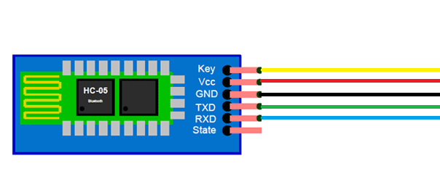
5V
5V
GND
TXD of Arduino
RXD of Arduino

